Slide 1
CS 371
Artificial Intelligence
Samyan Qayyum Wahla
Fall 2023
Course Credits: Stanford-CS221

Slide 2


Slide 3
Project Announcements
Completed So Far
  Project Groups
  Proposal Submission
  Understanding of Relevant Algorithms
  Poster
Whats Next?
  Run at least one algorithm from relevant algorithms
  demonstrate code and results
  Use existing Github Repositories
  Due Next Week

Slide 4
Quiz Announcement
Quiz 2
  November 23, 2023

Slide 5
Course Plan
Search problems
Markov decision processes
Adversarial games
Constraint satisfaction problems
Bayesian networks
Reflex
States
Variables
Logic
Low Level Intelligence
High Level Intelligence
Artificial Intelligence

Slide 6
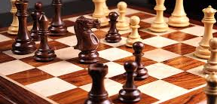
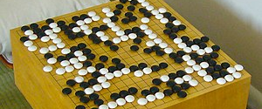
Search: Game Playing Techniques
Win, Loose or Draw

Slide 7
Reading Material for this Week
Chapter 6: Adversarial Search and Games
from
Artificial Intelligence: A Modern Approach
6.1, 6.2, 6.3 , 6.5, 6.7

Slide 8
Game playing challenges
Opponent – adds uncertainty
Contingency problem - The agent doesn't know what effect its actions will have. This could be due to the environment being partially observable, or because of another agent.
Big branching factor b i.e. Chess has average b of 35, 50 moves by each player, 35^100 nodes (b^2d).
Games with time limits: Penalized severely: Crucial

Slide 9

Simple Game
Adversarial search is basically a kind of search
in which one can trace the movement of an
enemy or opponent.
- Two players
-Turn-taking
- Perfect information
= Well known rules
- Smaller no of actions
Example
You choose one of the three bins.
I choose a number from that bin.
Your goal is to maximize the chosen number.
Two-player games.
  Chess
  Checkers
  Othello
A
B
C
-50 50
1 3
-5 15

Slide 10
Roadmap
Games, expectimax
Evaluation functions
Alpha-beta pruning
Minimax, expectiminimax

Slide 11

Game Tree
Key Idea: Game Tree
Each node is a decision point for a player.
Each root-to-leaf path is a possible outcome of the game.
-50
50
1
3
-5
15

Slide 12
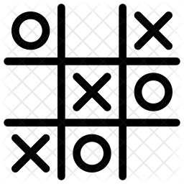
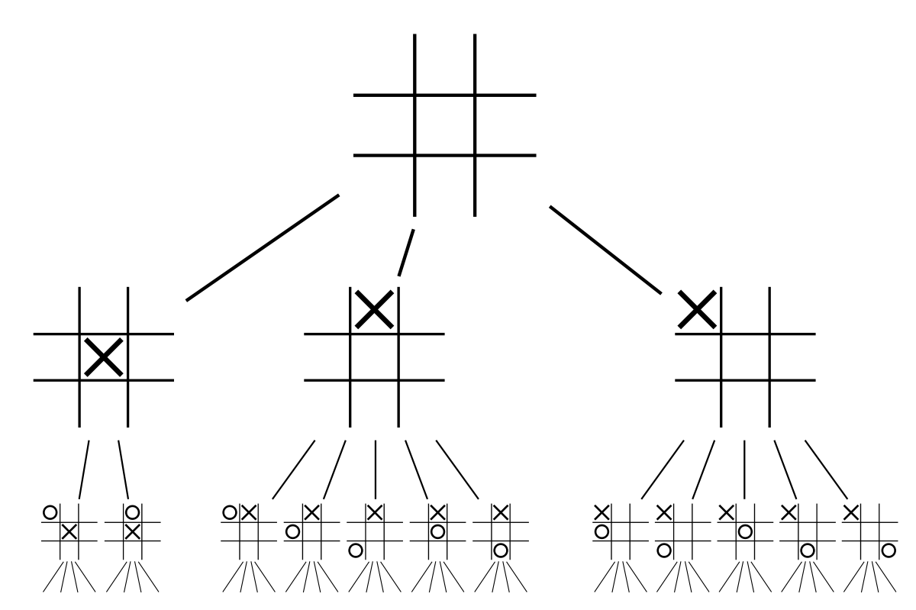
Key Points
Representation: Graphs/Game trees
“A game tree is a representation that is a semantic tree in which nodes denote board configurations and branches denotes moves”
Branching factor: b
Depth: d
Number of levels of the tree (including root): player of the game: p
p = d + 1
Move: Player’s choice and another player’s reaction

Slide 13
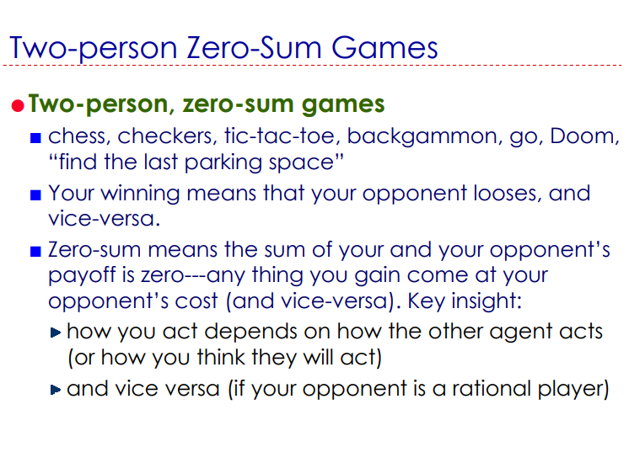

Slide 14

Two Player Zero Sum Game
Players = {agent, opp}
Definition
s_{start}: starting state
Actions(s): possible actions from state s
Succ(s, a): resulting state if choose action a in state s IsEnd(s): whether s is an end state (game over)
Utility(s): agent’s utility for end state s
Player(s) ∈ Players: player who controls state s

Slide 15
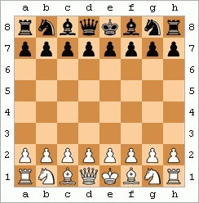
Example: Chess
Players = {white, black}
State s: (position of all pieces, whose turn it is) Actions(s): legal chess moves that Player(s) can make IsEnd(s): whether s is checkmate or draw
Utility(s): +∞ if white wins, 0 if draw, −∞ if black wins

Slide 16

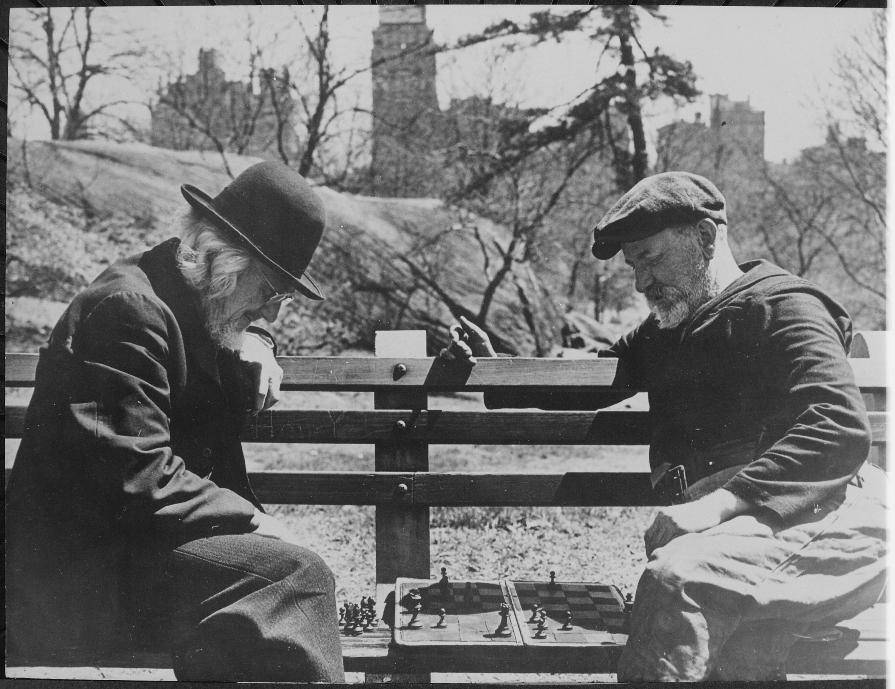
Characteristics of games
All the utility is at the end state
Different players in control at different states
Notes:
There are two important characteristics of games which make them hard.
The first is that the utility is only at the end state. In typical search problems and MDPs that we might encounter, there are costs and rewards associated with each edge. These intermediate quantities make the problem easier to solve. In games, even if there are cues that indicate how well one is doing (number of pieces, score), technically all that matters is what happens at the end. In chess, it doesn’t matter how many pieces you capture, your goal is just to checkmate the opponent’s king.
The second is the recognition that there are other people in the world! In search problems, you (the agent) controlled all actions. In MDPs, we already hinted at the loss of control where nature controlled the chance nodes, but we assumed we knew what distribution nature was using to transition. Now, we have another player that controls certain states, who is probably out to get us.

Slide 17

The halving game
Problem: halving game
Start with a number N .
N
Players take turns either decrementing N or replacing it with [ ]
2
The player that is left with 0 wins.

Slide 18
Halving Game Modelling
lass HalvingGame(object):
def __init__(self, N):
self.N = N
# state = (player, number) where player = +1 (agent) or -1 (opponent)
def startState(self):
return (+1, self.N)

Slide 19
def actions(self, state):
return ['-', '/']
def succ(self, state, action):
player, number = state
if action=='-':
return (-player, number - 1)
elif action=='/':
return (-player, number // 2)
def isEnd(self, state):
player, number = state
return number == 0

Slide 20
def utility(self, state):
assert self.isEnd(state)
player, number = state
return player * float('inf')
def player(self, state):
player, number = state
return player

Slide 21



Policies
You know about yourself
Deterministic policies: π_{p}(s) ∈ Actions(s)
action that player p takes in state s
Stochastic policies π_{p}(s, a) ∈ [0, 1]:
probability of player p taking action a in state s
You don’t know
about opp.
Notes:
Following our presentation of MDPs, we revisit the notion of a policy. Instead of having a single policy π, we have a policy π_{p} for each player p ∈ Players. We require that π_{p} only be defined when it’s p’s turn; that is, for states s such that Player(s) = p.
It will be convenient to allow policies to be stochastic. In this case, we will use π_{p}(s, a) to denote the probability of player p choosing action a in state s.
We can think of an MDP as a game between the agent and nature. The states of the game are all MDP states s and all chance nodes (s, a). It’s the agent’s turn on the MDP states s, and the agent acts according

Slide 22
Human Policy
def humanPolicy(game, state):
while True:
action = input('humanPolicy: please input action: ')
if action in game.actions(state):
return action

Slide 23
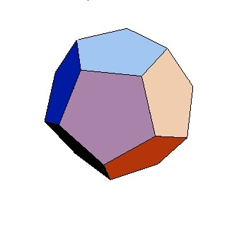
Game Evaluation Example
The value of a node is the
weighted average of the
values of the children where
the weights are given by the
probabilities of taking various
actions given by the policy
at that node.
Example: game evaluation
π_{agent}(s) = A
π_{opp}(s, a) = ¹ for a ∈ Actions(s)
0
2
(1) (0)
(0)
0
2
5
(0.5)
(0.5)
(0.5) (0.5)
(0.5)
(0.5)
-50
50
1 3
-5
15
Veval(sstart) = 0
Notes:
Given two policies π_{agent} and π_{opp}, what is the (agent’s) expected utility? That is, if the agent and the opponent were to play their (possibly stochastic) policies a large number of times, what would be the average utility? Remember, since we are working with zero-sum games, the opponent’s utility is the negative of the agent’s utility.
Given the game tree, we can recursively compute the value (expected utility) of each node in the tree. The value of a node is the weighted average of the values of the children where the weights are given by the probabilities of taking various actions given by the policy at that node.

Slide 24
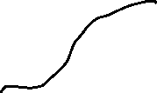
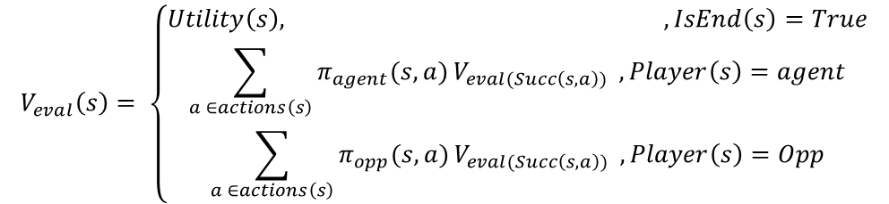
Game Evaluation Recurrence
Three possibilities
Analogy: recurrence for policy evaluation in MDPs
πagent
πopp
πagent
...
$$V_{eval}\left(s\right)= \left\{\begin{aligned}Utility\left(s\right), ,IsEnd\left(s\right)=True \\ \sum_{a ∈actions\left(s\right)}{π_{agent}(s,a){V_{eval(Succ\left(s,a\right))} , Player\left(s\right)=agent}} \\ \sum_{a ∈actions\left(s\right)}{π_{opp}(s,a){V_{eval(Succ\left(s,a\right))} , Player\left(s\right)=Opp}}\end{aligned}\right.$$
Notes:
More generally, we can write down a recurrence for V_{eval}(s), which is the value (expected utility) of the game at state s.
There are three cases: If the game is over (IsEnd(s)), then the value is just the utility Utility(s). If it’s the agent’s turn, then we compute the expectation over the value of the successor resulting from the agent choosing an action according to π_{agent}(s, a). If it’s the opponent’s turn, we compute the expectation with respect to π_{opp} instead.

Slide 25
policies = {
+1: humanPolicy,
-1: humanPolicy
}
game = HalvingGame(15)
state = game.startState()
while not game.isEnd(state):
print('='*10, 'state = {}'.format(state))
player = game.player(state)
policy = policies[player]
action = policy(game, state)
state = game.succ(state, action)
print('utility = {}'.format(game.utility(state)))

Slide 26
Expectimax Example
Example: expectimax
π_{opp}(s, a) = ¹ for a ∈ Actions(s)
2
5
 | 0 |  | 2 |  |  |  | 5
(0.5) | (0.5) |  | (0.5) (0.5) |  |  | (0.5) | (0.5)
-50 | 50 | 1 |  | 3 | -5 |  | 15
Vexptmax(sstart) = 5

Slide 27


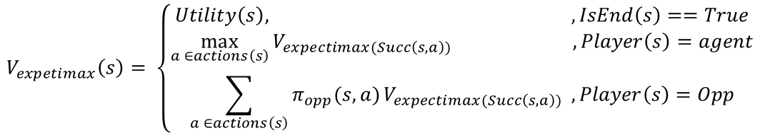

Expectimax Recurrence
Analogy: recurrence for value iteration in MDPs
πagent
πopp
πagent
...
Utility of agent
$$V_{expetimax}\left(s\right)= \left\{\begin{aligned}Utility\left(s\right), ,IsEnd\left(s\right)==True \\ \max_{a ∈actions\left(s\right)}{V_{expectimax(Succ\left(s,a\right))} ,Player\left(s\right)=agent} \\ \sum_{a ∈actions\left(s\right)}{π_{opp}(s,a){V_{expectimax(Succ\left(s,a\right))} , Player\left(s\right)=Opp}}\end{aligned}\right.$$
Utility of opponent
Notes:
The recurrence for the expectimax value V_{exptmax} is exactly the same as the one for the game value V_{eval}, except that we maximize over the agent’s actions rather than following a fixed agent policy (which we don’t know now).
Where game evaluation was the analogue of policy evaluation for MDPs, expectimax is the analogue of value iteration.

Slide 28
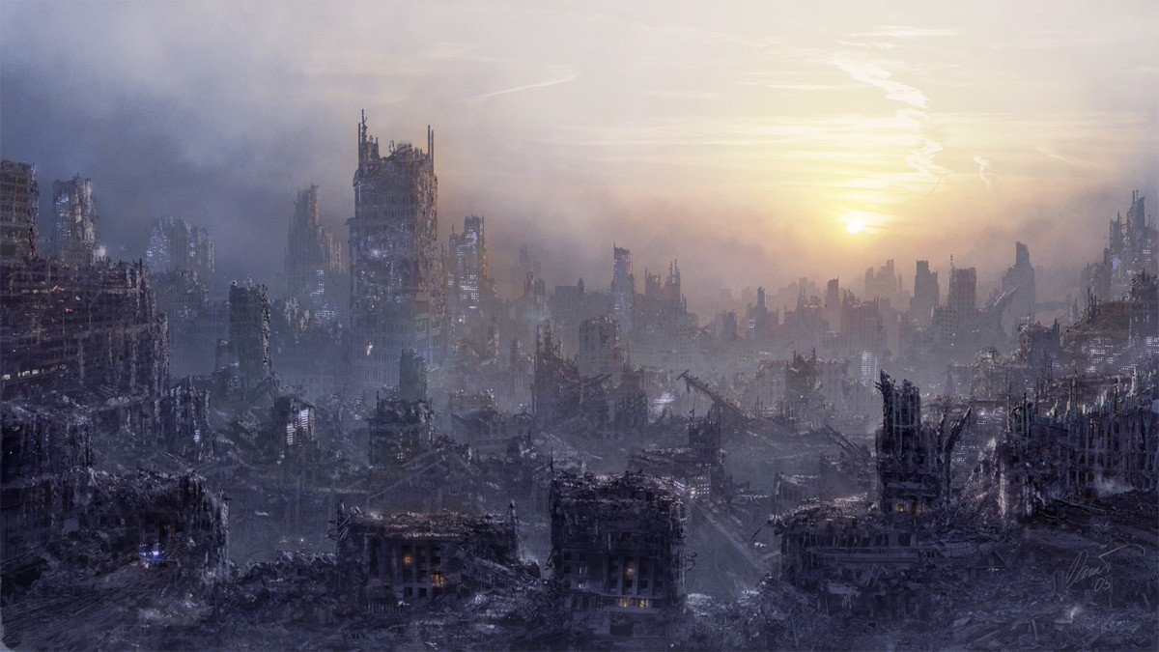
Unknown Policy of the Opponent
Problem: don’t know opponent’s policy
Approach: assume the worst case

Slide 29
Roadmap
Games, expectimax
Evaluation functions
Alpha-beta pruning
Minimax, expectiminimax

Slide 30
Minimax Example
Example: minimax
1
-50
1
-5
-50
50
1 3
-5
15
Vminmax(sstart) = 1
Notes:
If we could perform some mind-reading and discover the opponent’s policy, then we could maximally exploit it. However, in practice, we don’t know the opponent’s policy. So our solution is to assume the worst case, that is, the opponent is doing everything to minimize the agent’s utility.
In the game tree, we use an upside-down triangle to represent min nodes, in which the player minimizes the value over possible actions.
Note that the policy for the agent changes from choosing the rightmost action (expectimax) to the middle action. Why is this?

Slide 31
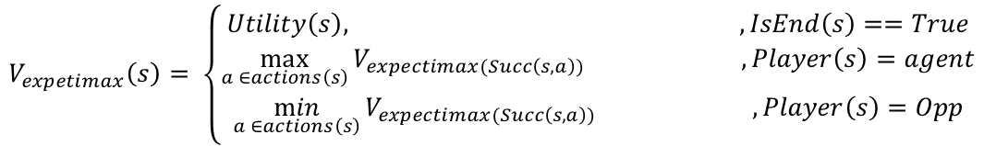
Minimax Recurrence
No analogy in MDPs:
πagent
πopp
πagent
...
$$V_{expetimax}\left(s\right)= \left\{\begin{aligned}Utility\left(s\right), ,IsEnd\left(s\right)==True \\ \max_{a ∈actions\left(s\right)}{V_{expectimax(Succ\left(s,a\right))} ,Player\left(s\right)=agent} \\ \min_{a ∈actions\left(s\right)}{V_{expectimax(Succ\left(s,a\right))} ,Player\left(s\right)=Opp}\end{aligned}\right.$$
Notes:
The general recurrence for the minimax value is the same as expectimax, except that the expectation over the opponent’s policy is replaced with a minimum over the opponent’s possible actions. Note that the minimax value does not depend on any policies at all: it’s just the agent and opponent playing optimally with respect to each other.

Slide 32
Extracting minimax policies
π_{max}(s) = arg
max V_{minmax}(Succ(s, a))
a∈Actions(s)
min V_{minmax}(Succ(s, a))
a∈Actions(s)
π_{min}(s) = arg
1
-50
1
-5
-50
50
1
3
-5
15
Notes:
Having computed the minimax value V_{minmax}, we can extract the minimax policies π_{max} and π_{min} by just taking the action that leads to the state with the maximum (or minimum) value.
In general, having a value function tells you which states are good, from which it’s easy to set the policy to move to those states (provided you know the transition structure, which we assume we know here).

Slide 33
The Halving Game
Problem: halving game
Start with a number N .
N
Players take turns either decrementing N or replacing it with [ ♩.
2
The player that is left with 0 wins.

Slide 34
Minimax Policy in Action
def minimaxPolicy(game, state):
# recursively find (utility, bestAction)
def recurse(state):
if game.isEnd(state):
return (game.utility(state), None)
choices = [
(recurse(game.succ(state, action))[0], action)
for action in game.actions(state)
]
if game.player(state) == +1:
return max(choices)
elif game.player(state) == -1:
return min(choices)
value, action = recurse(state)
print('minimaxPolicy: action = {}, value = {}'.format(action, value))
return action

Slide 35



Face Off
I am going to maximize my policy &
I don’t care what is opp.’s policy.
Recurrences produces policies:
Vexptmax Vminmax
⇒ π_{exptmax(7)}, π₇ (some opponent)
⇒ πmax, πmin
Play policies against each other:
Opp
agent
πmin
π₇
πmax
V (π_{max}, π_{min})
V (π_{max}, π₇)
^{π}exptmax(7) ^{V (π}exptmax(7)^{, π}min^{) V (π}exptmax(7)^{, π}7⁾
What’s the relationship between these values?

Slide 36

Minimax Property 1
Proposition: best against minimax opponent
V (π_{max}, π_{min}) ≥ V (π_{agent}, π_{min}) for all π_{agent}
1
-50
1
-5
-50
50
1
3
-5
15
Notes:
Recall that π_{max} and π_{min} are the minimax agent and opponent policies, respectively. The first property is if the agent were to change her policy to any π_{agent}, then the agent would be no better off (and in general, worse off).
From the example, it’s intuitive that this property should hold. To prove it, we can perform induction starting from the leaves of the game tree, and show that the minimax value of each node is the highest over all possible policies.

Slide 37
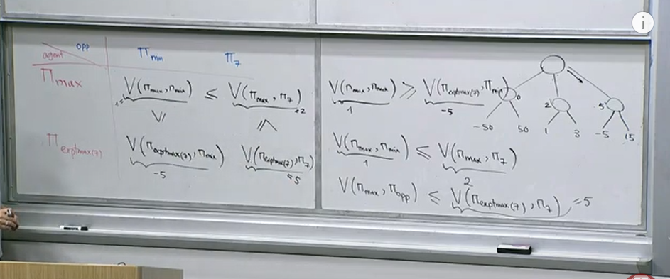
Properties 1, 2, 3

Slide 38
Minimax Property 2
Proposition: lower bound against any opponent
V (π_{max}, π_{min}) ≤ V (π_{max}, π_{opp}) for all π_{opp}
1
-50
1
-5
-50
50
1
3
-5
15

Slide 39
Minimax Property 3
Proposition: not optimal if opponent is known
V (π_{max}, π₇) ≤ V (π_{exptmax(7)}, π₇) for opponent π₇
5
 | 0 |  | 2 |  |  |  | 5
(0.5) | (0.5) |  | (0.5) (0.5) |  |  | (0.5) | (0.5)
-50 | 50 | 1 |  | 3 | -5 |  | 15
Notes:
However, following the minimax policy might not be optimal for the agent if the opponent is known to be not playing the adversarial (minimax) policy.
Consider the running example where the agent chooses A, B, or C and the opponent chooses a bin. Suppose the agent is playing π_{max}, but the opponent is playing a stochastic policy π₇ corresponding to choosing an action uniformly at random.
Then the game value here would be 2 (which is larger than the minimax value 1, as guaranteed by property 2). However, if we followed the expectimax π_{exptmax(7)}, then we would have gotten a value of 5, which is even higher.

Slide 40
Relationship between game values
-50
50
1
3
-5
15
πmin
π₇
V (π_{max}, π_{min})
1
V (π_{max}, π₇)
2
πmax
≤
≥
≤
^{V (π}exptmax(7)^{, π}min⁾
^{π}exptmax(7) ₋₅
^{V (π}exptmax(7)^{, π}7⁾
5
Notes:
Putting the three properties together, we obtain a chain of inequalities that allows us to relate all four game values.
We can also compute these values concretely for the running example.

Slide 41
A Modified Game
Example: game 2
You choose one of the three bins.
Flip a coin; if heads, then move one bin to the left (with wrap around).
I choose a number from that bin.
Your goal is to maximize the chosen number.
A B C
-50 50 1 3 -5 15
Notes:
Now let us consider games that have an element of chance that does not come from the agent or the opponent. Or in the simple modified game, the agent picks, a coin is flipped, and then the opponent picks.
It turns out that handling games of chance is just a straightforward extension of the game framework that we have already.

Slide 42

Expetiminimax Example
Example: expectiminimax
π_{coin}(s, a) = ¹ for a ∈ {0, 1}
2
-2
-27.5
-24.5
-2
(0.5)
(0.5)
(0.5)
(0.5)
(0.5)
(0.5)
-50
-5
1
-50
-5
1
-50
50
-5
15
1 3 -50 50
Vexptminmax(sstart) = −2
-5
15
1
3

Slide 43
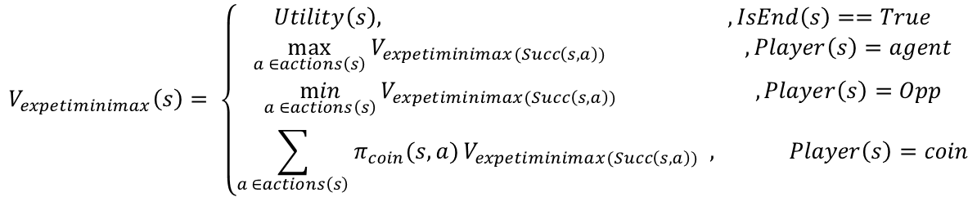
Expectiminimax Recurrence
Players = {agent, opp, coin}
πagent
πcoin
πopp
...
$$V_{expetiminimax}\left(s\right)= \left\{\begin{aligned}Utility\left(s\right), ,IsEnd\left(s\right)==True \\ \max_{a ∈actions\left(s\right)}{V_{expetiminimax(Succ\left(s,a\right))} ,Player\left(s\right)=agent} \\ \min_{a ∈actions\left(s\right)}{V_{expetiminimax(Succ\left(s,a\right))} ,Player\left(s\right)=Opp} \\ \sum_{a ∈actions\left(s\right)}{π_{coin}(s,a){V_{expetiminimax(Succ\left(s,a\right))} , Player\left(s\right)=coin}}\end{aligned}\right.$$

Slide 44
Summary So Far
Primitives: max nodes, chance nodes, min nodes
Composition: alternate nodes according to model of game Value function V···(s): recurrence for expected utility Scenarios to think about:
What if you are playing against multiple opponents?
What if you and your partner have to take turns (table tennis)?
Some actions allow you to take an extra turn?
Notes:
In summary, so far, we’ve shown how to model a number of games using game trees, where each node of the game tree is either a max, chance, or min node depending on whose turn it is at that node and what we believe about that player’s policy.
Using these primitives, one can model more complex turn-taking games involving multiple players with heterogeneous strategies and where the turn-taking doesn’t have to strictly alternate. The only restriction is that there are two parties: one that seeks to maximize utility and the other that seeks to minimize utility, along with other players who have known fixed policies (like coin).

Slide 45
Computations
1
-50
1
-5
-50 50 1 3 -5 15
Approach: tree search Complexity:
branching factor b, depth d (2d plies)
O(d) space, O(b^{2d}) time Chess: b approx.= 35, d approx.= 50
25515520672986852924121150151425587630190414488161019324176778440771467258239937365843732987043555789782336195637736653285543297897675074636936187744140625
Player has moved d times. Each level in the tree is called a ply. The number of plies is the depth times the number of players.
Notes:
Thus far, we’ve only touched on the modeling part of games. The rest of the lecture will be about how to actually compute (or approximately compute) the values of games.
The first thing to note is that we cannot avoid exhaustive search of the game tree in general. Recall that a state is a summary of the past actions which is sufficient to act optimally in the future. In most games, the future depends on the exact position of all the pieces, so we cannot forget much and exploit dynamic programming.
Second, game trees can be enormous. Chess has a branching factor of around 35 and go has a branching factor of up to 361 (the number of moves to a player on his/her turn). Games also can last a long time, and therefore have a depth of up to 100.
A note about terminology specific to games: A game tree of depth d corresponds to a tree where each
player has moved d times. Each level in the tree is called a ply. The number of plies is the depth times the number of players.

Slide 46

Speeding up minimax
Evaluation functions: use domain-specific knowledge, compute ap- proximate answer
Alpha-beta pruning: general-purpose, compute exact answer

Slide 47
Roadmap
Games, expectimax
Evaluation functions
Alpha-beta pruning
Minimax, expectiminimax

Slide 48
Depth Limited Search

Slide 49
Evaluation Functions
Definition: Evaluation function
An evaluation function Eval(s) is a (possibly very weak) estimate of the value V_{minmax}(s).
Analogy: FutureCost(s) in search problems
Notes:
The first idea on how to speed up minimax is to search only the tip of the game tree, that is down to depth d_{max}, which is much smaller than the total depth of the tree D (for example, d_{max} might be 4 and D = 50).
We modify our minimax recurrence from before by adding an argument d, which is the maximum depth that we are willing to descend from state s. If d = 0, then we don’t do any more search, but fall back to an evaluation function Eval(s), which is supposed to approximate the value of V_{minmax}(s) (just like the heuristic h(s) approximated FutureCost(s) in A* search).
If d > 0, we recurse, decrementing the allowable depth by one at only min nodes, not the max nodes. This is because we are keeping track of the depth rather than the number of plies.

Slide 50
Evaluation functions
Example: chess
Eval(s) = material + mobility + king-safety + center-control material = 10¹⁰⁰(K − K′) + 9(Q − Q′) + 5(R − R′)+
3(B − B′ + N − N ′) + 1(P − P ′)
mobility = 0.1(num-legal-moves − num-legal-moves′)
...
Notes:
Now what is this mysterious evaluation function Eval(s) that serves as a substitute for the horrendously hard V_{minmax} that we can’t compute?
Just as in A*, there is no free lunch, and we have to use domain knowledge about the game. Let’s take chess for example. While we don’t know who’s going to win, there are some features of the game that are likely indicators. For example, having more pieces is good (material), being able to move them is good (mobility), keeping the king safe is good, and being able to control the center of the board is also good. We can then construct an evaluation function which is a weighted combination of the different properties.
For example, K − K′ is the difference in the number of kings that the agent has over the number that the opponent has (losing kings is really bad since you lose then), Q − Q′ is the difference in queens, R − R′ is the difference in rooks, B − B′ is the difference in bishops, N − N ′ is the difference in knights, and P − P ′ is the difference in pawns.

Slide 51
Evaluation function
Must agree with the utility function on terminal states
Must not take too long
Should reflect the actual chance of winning
The material advantage evaluation function assumes that the value of a piece can be judged independently of the other pieces present on the board. This kind of evaluation is called weighted linear function
  W1f1 + w2f2 + ….. Wnfn
  Where w’s are the weights, and the f’s are the features of the particular position

Slide 52
Heuristics Methods
Finish games with allowed limit
Progressive Deepening – Fixed depths
Conservative choice for depth – Less search
Leaf level: # of nodes requiring static evaluations = b^d
Algorithm for PDS:
Set depth = 1
Start search
If time ends, stop. Otherwise increase the depth and go to step 2.

Slide 53


Number of nodes in tree (without leaf level)
Ration: # of nodes in the bottom level / # of nodes up to bottom level

Slide 54
Summary Evaluation Functions
Depth-limited exhaustive search: O(b^{2d}) time
Eval(s) attempts to estimate V_{minmax}(s) using domain knowledge
No guarantees (unlike A*) on the error from approximation
Notes:
To summarize, this section has been about how to make naive exhaustive search over the game tree to compute the minimax value of a game faster.
The methods so far have been focused on taking shortcuts: only searching up to depth d and relying on an evaluation function, and using a cheaper mechanism for estimating the value at a node rather than search its entire subtree.

Slide 55
Roadmap
Games, expectimax
Evaluation functions
Alpha-beta pruning
Minimax, expectiminimax

Slide 56
Pruning Principal
Choose A or B with maximum value:
A: [3, 5]
B: [5, 100]
Key idea: branch and bound
Maintain lower and upper bounds on values.
If intervals don’t overlap non-trivially, then can choose optimally without further work.
Notes:
We continue on our quest to make minimax run faster based on pruning. Unlike evaluation functions, these are general purpose and have theoretical guarantees.
The core idea of pruning is based on the branch and bound principle. As we are searching (branching), we keep lower and upper bounds on each value we’re trying to compute. If we ever get into a situation where we are choosing between two options A and B whose intervals don’t overlap or just meet at a single point (in other words, they do not overlap non-trivially), then we can choose the interval containing larger values (B in the example). The significance of this observation is that we don’t have to do extra work to figure out the precise value of A.

Slide 57
“If you have an idea that is surely bad, do not take time to see how truly awful it is”

Slide 58
Pruning Game Tree
3
3
≤ 2
3 5 2 10
Once see 2, we know that value of right node must be ≤ 2
Root computes max(3, ≤ 2) = 3
Since branch doesn’t affect root value, can safely prune
Notes:
In the context of minimax search, we note that the root node is a max over its children.
Once we see the left child, we know that the root value must be at least 3.
Once we get the 2 on the right, we know the right child has to be at most 2.
Since those two intervals are non-overlapping, we can prune the rest of the right subtree and not explore it.

Slide 59
Alpha-Beta Pruning
Key idea: optimal path
The optimal path is path that minimax policies take. Values of all nodes on path are the same.
a_{s}: lower bound on value of max
≥ 6
node s
b_{s}: upper bound on value of min
node s
...
≤ 8
Prune a node if its interval
doesn’t have non-trivial over-
lap with every ancestor (store α_{s} = max_{s}' _{≤s} a_{s} and β_{s} = min_{s}' _{≤s} b_{s})
...
≥ 3
...
≤ 5
Notes:
In general, let’s think about the minimax values in the game tree. The value of a node is equal to the utility of at least one of its leaf nodes (because all the values are just propagated from the leaves with min and max applied to them). Call the first path (ordering by children left-to-right) that leads to the first such leaf node the optimal path. An important observation is that the values of all nodes on the optimal path are the same (equal to the minimax value of the root).
Since we are interested in computing the value of the root node, if we can certify that a node is not on the optimal path, then we can prune it and its subtree.
To do this, during the depth-first exhaustive search of the game tree, we think about maintaining a lower bound (≥ a_{s}) for all the max nodes s and an upper bound (≤ b_{s}) for all the min nodes s.
If the interval of the current node does not non-trivially overlap the interval of every one of its ancestors, then we can prune the current node. In the example, we’ve determined the root’s node must be ≥ 6. Once we get to the node on at ply 4 and determine that node is ≤ 5, we can prune the rest of its children since it is impossible that this node will be on the optimal path (≤ 5 and ≥ 6 are incompatible). Remember that all the nodes on the optimal path have the same value.
Implementation note: for each max node s, rather than keeping a_{s}, we keep α_{s}, which is the maximum value of a_{s}' over s and all its max node ancestors. Similarly, for each min node s, rather than keeping b_{s}, we keep β_{s}, which is the minimum value of b_{s}' over s and all its min node ancestors. That way, at any given node, we can check interval overlap in constant time regardless of how deep we are in the tree.

Slide 60
Aplha-Beta Pruning Example
9
7
6
8
3
3
4
7
9

Slide 61
Move Ordering
Pruning depends on order of actions.
Can’t prune the 5 node:
3
2
3
2
10
3
5

Slide 62
Move Ordering
Which ordering to choose?
Worst ordering: O(b^{2·d}) time
Best ordering: O(b^{2·0.5d}) time
Random ordering: O(b^{2·0.75d}) time
In practice, can use evaluation function Eval(s):
Max nodes: order successors by decreasing Eval(s)
Min nodes: order successors by increasing Eval(s)
Notes:
In the worst case, we don’t get any savings.
If we use the best possible ordering, then we save half the exponent, which is significant. This means that if could search to depth 10 before, we can now search to depth 20, which is truly remarkable given that the time increases exponentially with the depth.
In practice, of course we don’t know the best ordering. But interestingly, if we just use a random ordering, that allows us to search 33 percent deeper.
We could also use a heuristic ordering based on a simple evaluation function. Intuitively, we want to search
children that are going to give us the largest lower bound for max nodes and the smallest upper bound for min nodes.

Slide 63
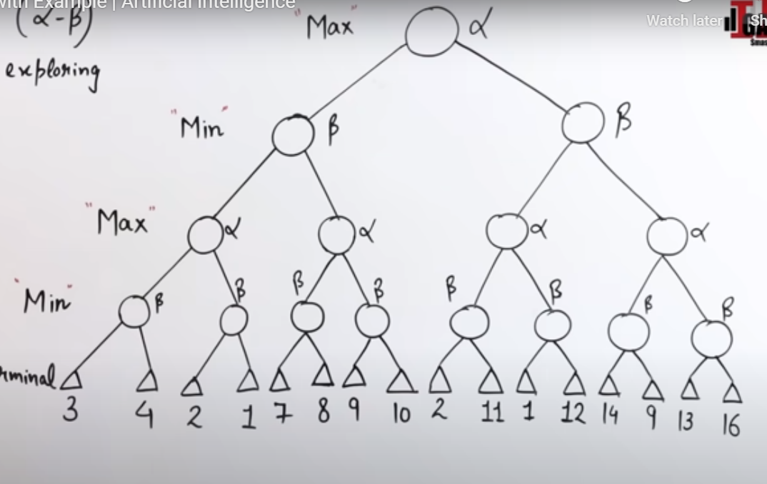

Slide 64
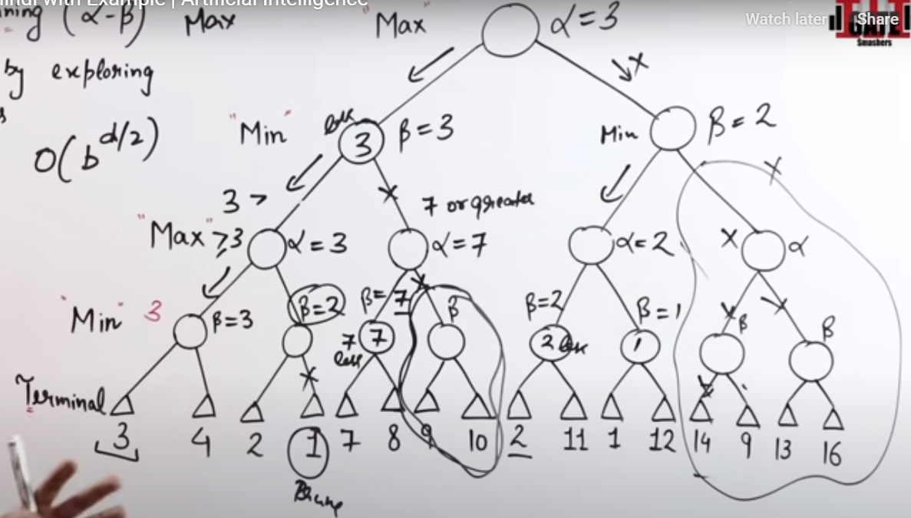

Slide 65
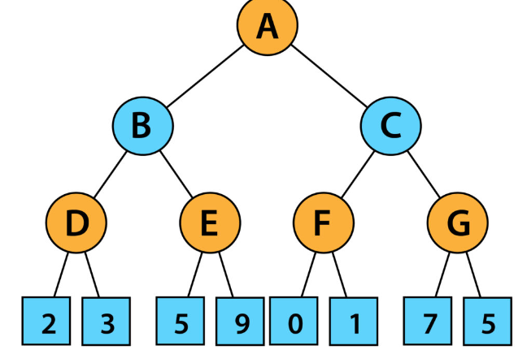

Slide 66
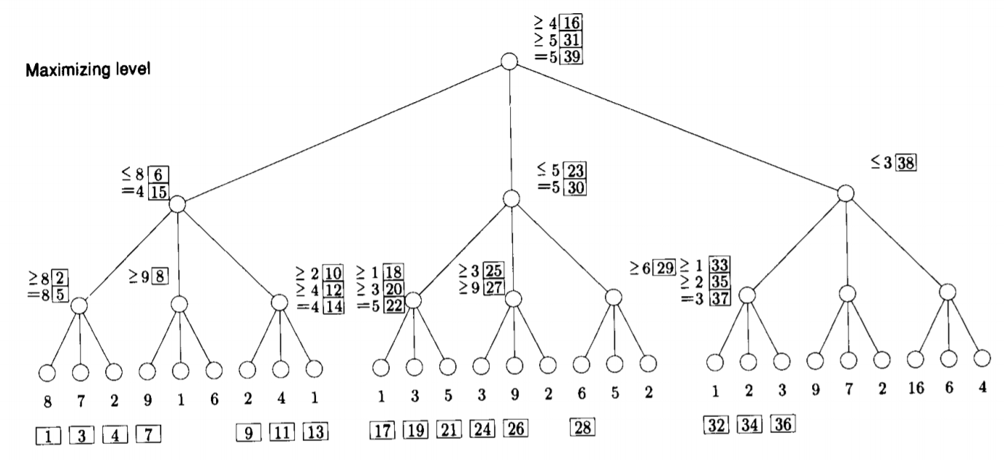

Slide 67
Alpha-Beta Procedure
For larger d, will one level exploration enough?
Deep cutoffs can occur with deeper trees (four or more levels)
How to keep track of big cutoff searching?
  Alpha and beta parameters
  Starting value at root: alpha : -ve infinity and beta: +ve infinity
  Alpha-beta then calls recursively, narrowing ranging between alpha and beta values
Cuts exponent of exponential explosion in half
Tree with depth 3 and b = 3, procedures reduces static evaluations from 27 to 11.

Slide 68
Alpha-beta procedure
If the level is the top level, let alpha be –ve infinity and let beta be +ve infinity
If the limit of search has been reached, compute the static value of the current position relative to the appropriate player. Report the result.
If the level is the minimizing level,
  Until all children are examined with alpha-beta or until alpha is equal to or greater than beta,
    Use the alpha-beta procedure, with the current alpha and beta values, on a child; note the value reported
    Compare the value reported with the beta value; if the reported value is smaller, reset beta to the new value
    Report beta
Otherwise, the level is a maximizing level:
Until all children are examined with alpha-beta or until alpha is equal to or greater than beta,
  Use the alpha-beta procedure, with the current alpha and beta values, on a child; note the value reported
  Compare the value reported with the alpha value; if the reported value is smaller, reset alpha to the new value
  Report alpha

Slide 69
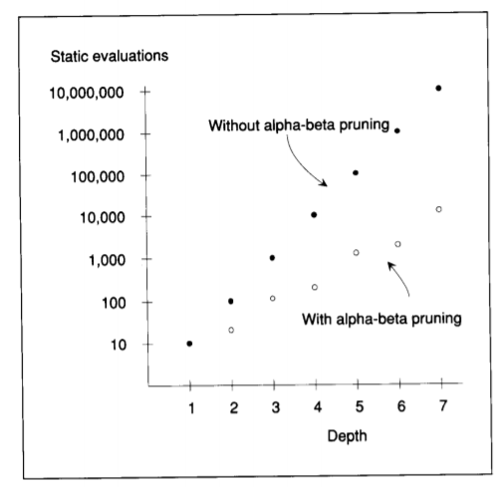

Number of static evaluations: s

Slide 70
Summary
1
-50
1
-5
-50
50
1
3
-5
15
Game trees: model opponents, randomness
Minimax: find optimal policy against an adversary
Evaluation functions: domain-specific, approximate
Alpha-beta pruning: domain-general, exact

